Slide 1
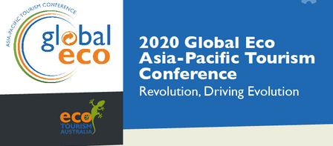




Geoparks
A powerful development vehicle for Australia
Professor Ross Dowling AM
Chair – Australian Geoparks Network
Vice President – Geoparks WA
Global ECO Conference
Margaret River, WA
Thursday 3 December 2020

Slide 2


Geoparks
A powerful new driver
of sustainable
regional development

Slide 3
Geoparks are not
National Parks
Notes:
3

Slide 4
Geoparks
A Geopark is a UNESCO initiative which starts with geology and landscape to foster sustainable regional economic development
Geoparks foster conservation, community well-being and economic development

Slide 5
Geopark Essentials
The five fundamental features of a UNESCO Global Geopark are:
Geological heritage of international value
A clear boundary and good governance
Visibility - information and promotion
Networking – within the park and across the global network
Geoparks are re-evaluated every 4 years

Slide 6
Geotourism is not Ecotourism and it is not
Geological Tourism
Geoparks are powered by Geotourism
Notes:
6

Slide 7

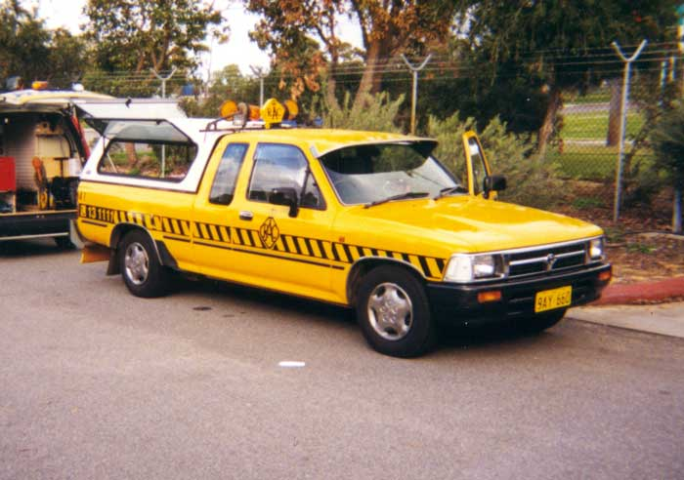

Geoparks & Geotourism
Geoparks
are the vehicle
Geotourism
is the engine
Notes:
7

Slide 8
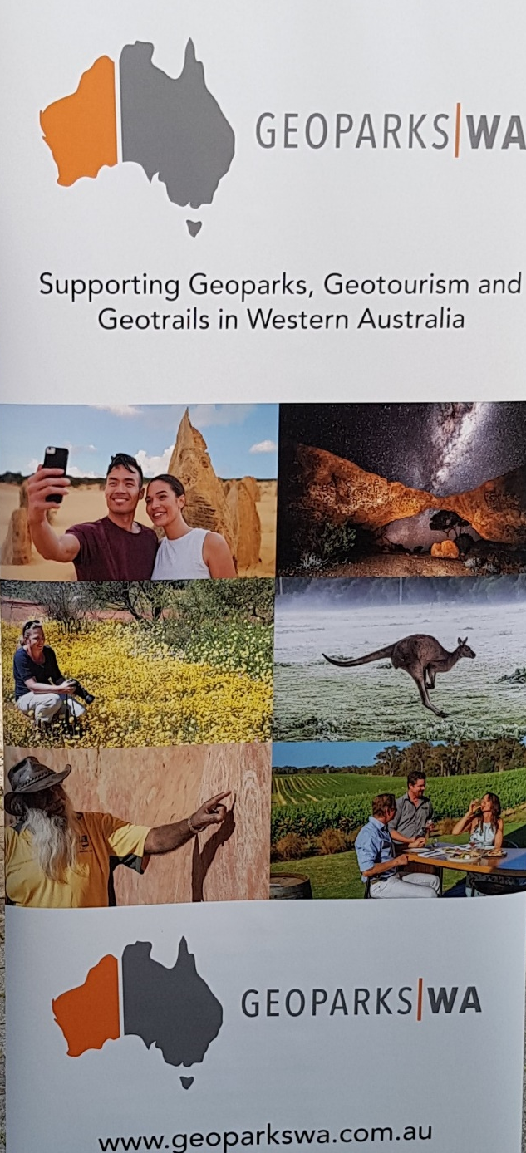
Geotourism’s ‘ABC’
Abiotic – non living parts of the environment – earth geology (landscape & landforms) and sky (astrology & climate)
Biotic – the living parts of the environment - both plants (flora) and animals (fauna)
Culture – people past and present
Notes:
8

Slide 9
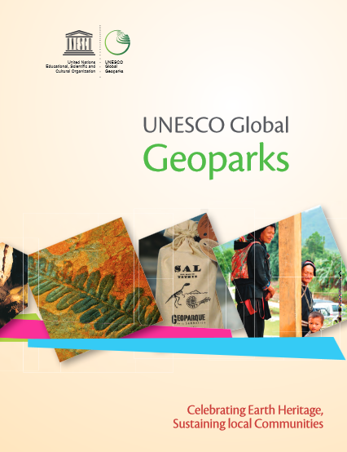
Levels of Geoparks
Level
Aspiring
National
Global
Notes:
9

Slide 10
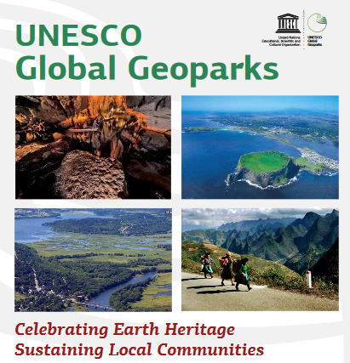


Slide 11
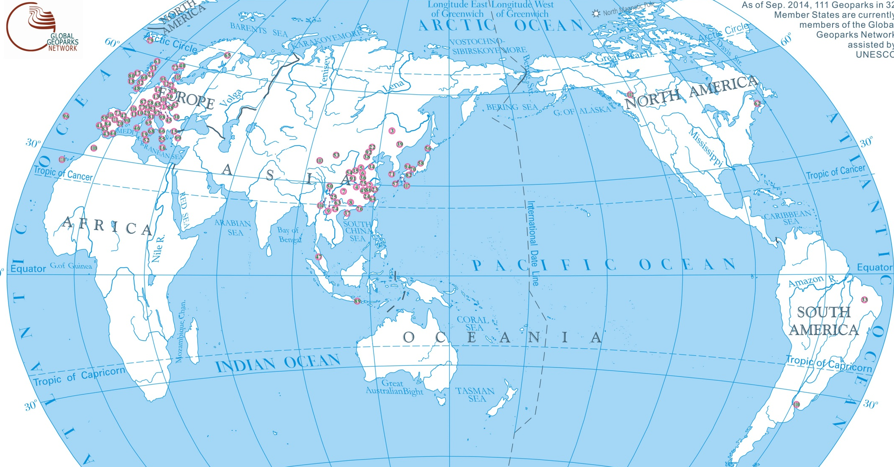
UNESCO Global Geoparks
[161 in 44 countries]
Europe [75]
China [41]
S. Korea [4]
Canada [5]
Japan [9]
Morocco
Iran
Thailand
Mexico [2]
Vietnam [3]
Nicaragua
Malaysia
Ecuador
Tanzania
Indonesia [5]
Peru
Brazil
Uruguay

Slide 12
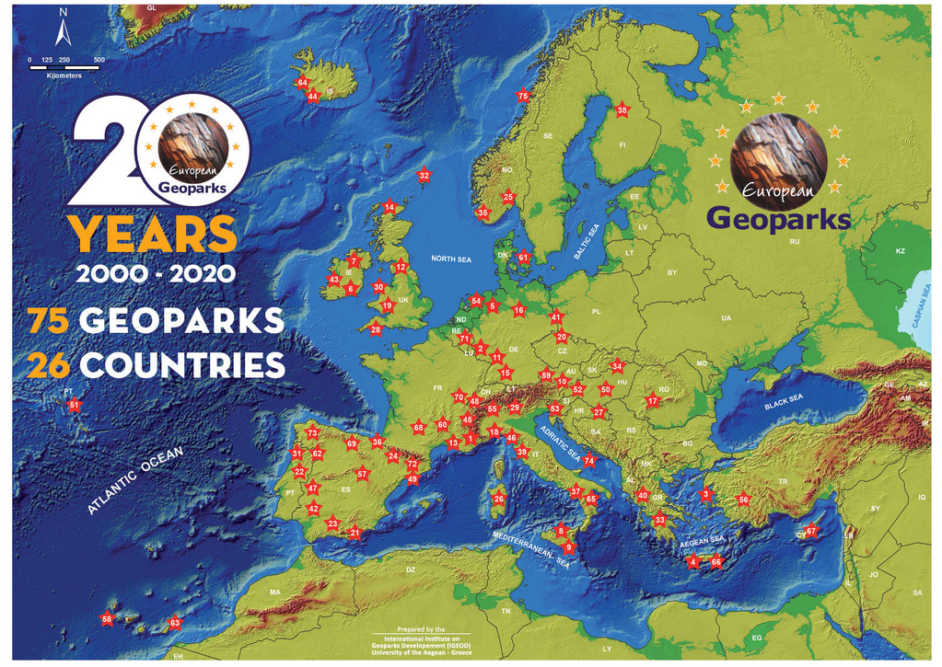

Slide 13

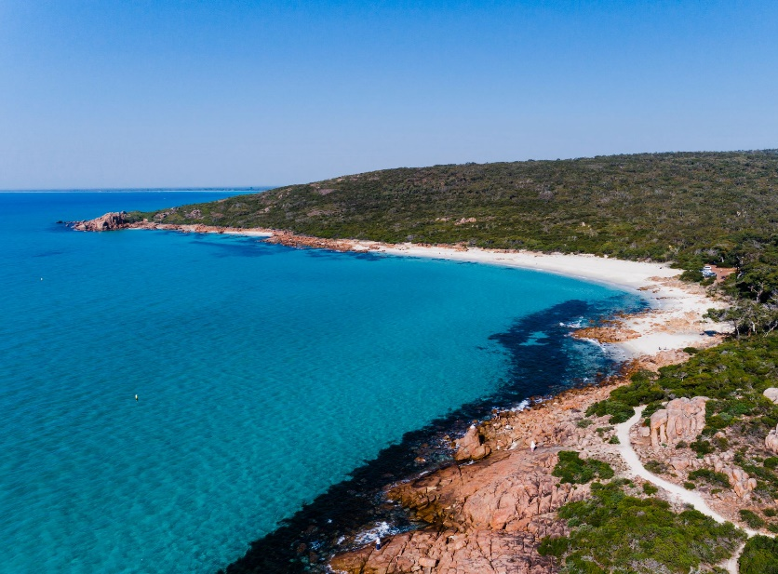
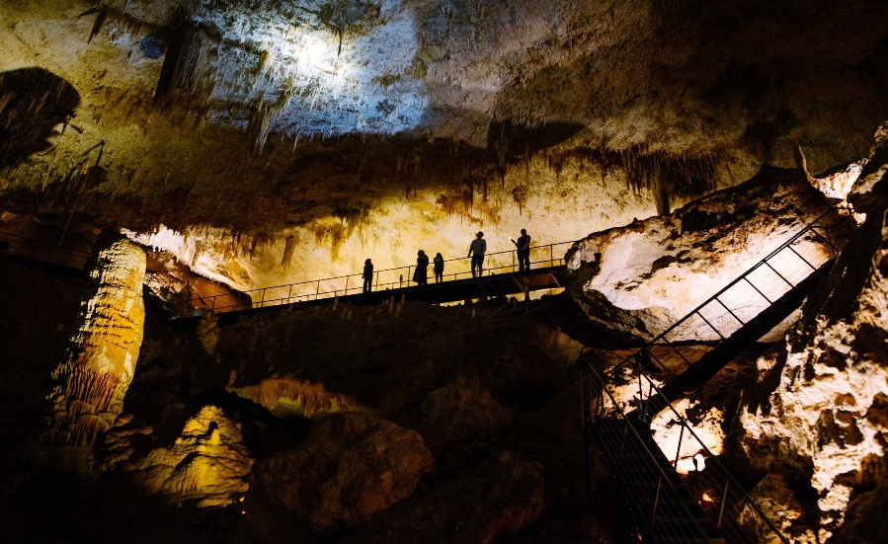
Geoparks are vehicles for
Economic growth
Job creation
Community well-being
Conservation
Tourism development
Educational links
Scientific research
Cultural revival
Aboriginal enterprise
A global network

Slide 14
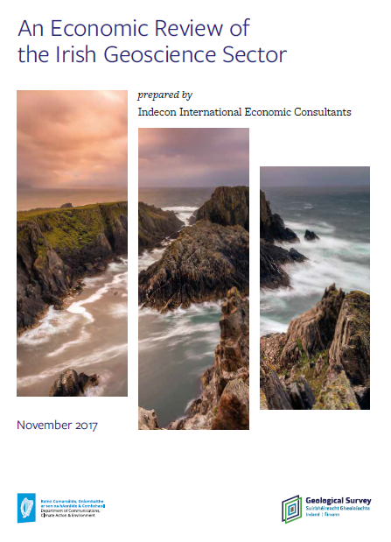
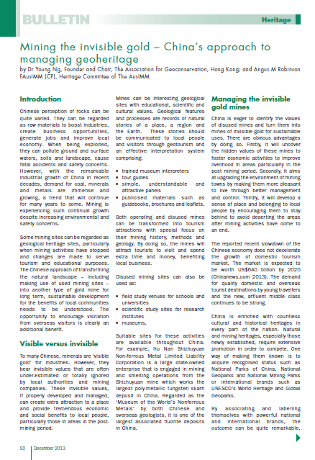
Economic Benefits
Geoparks generate jobs, stimulate the economy
and contribute to regional development
Ireland
China

Slide 15
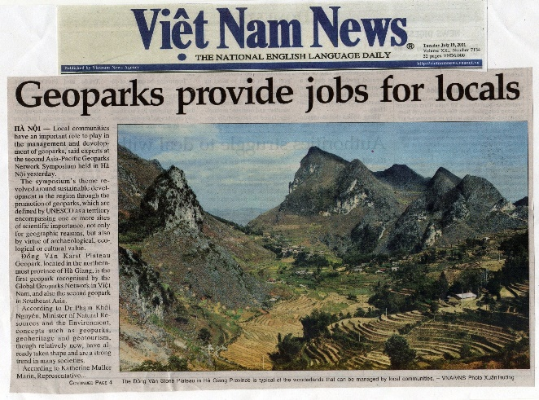

Slide 16


UNESCO Programs
Program | Sites | Countries
World Heritage | 1121 | 167
Man and the Biosphere | 701 | 124
UNESCO Global Geoparks | 161 | 44

Slide 17
Australia’s UNESCO Programs
Program | Australia | WA
World Heritage | 20 | 4
Man and the Biosphere | 10 | 1
UNESCO Global Geoparks | 0 | 0

Slide 18
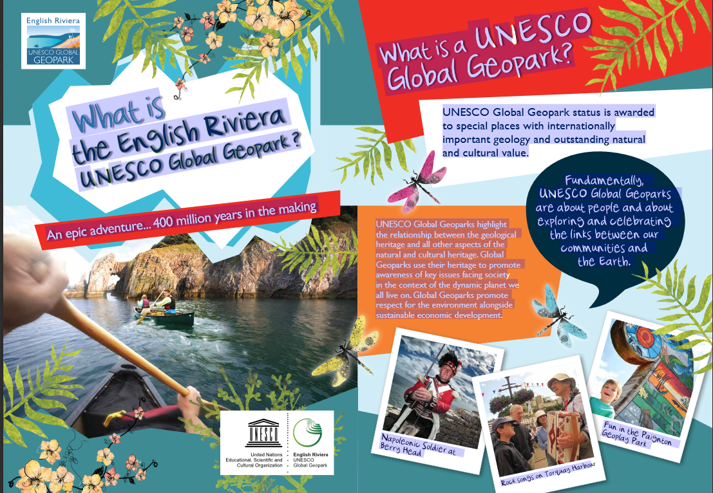

Slide 19
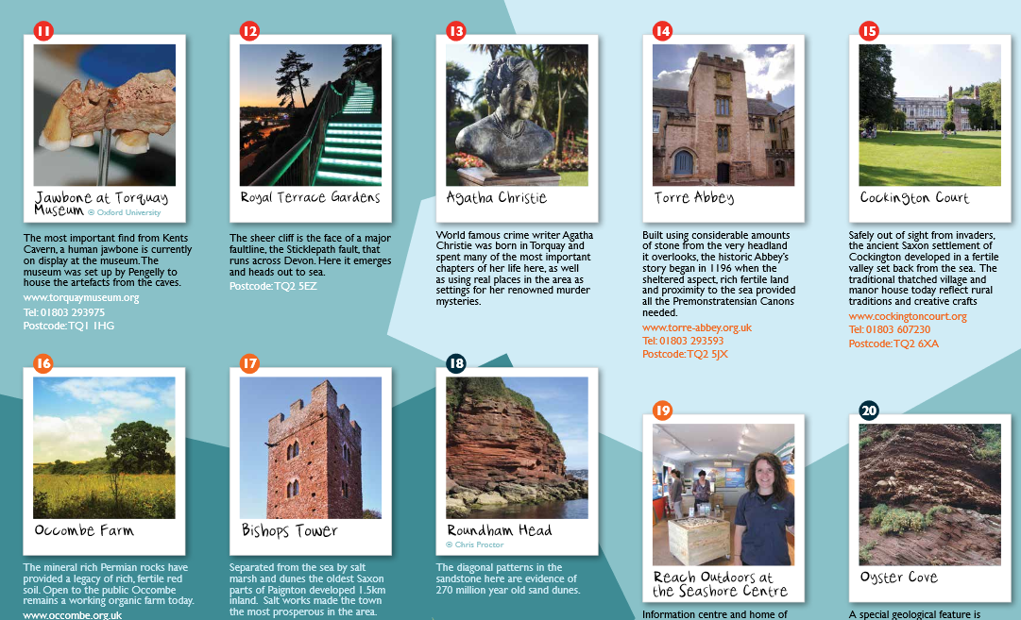
Museum
Gardens
Museum
Church
Courtyard
Farm
Tower
Head
Research
Centre
Cove

Slide 20
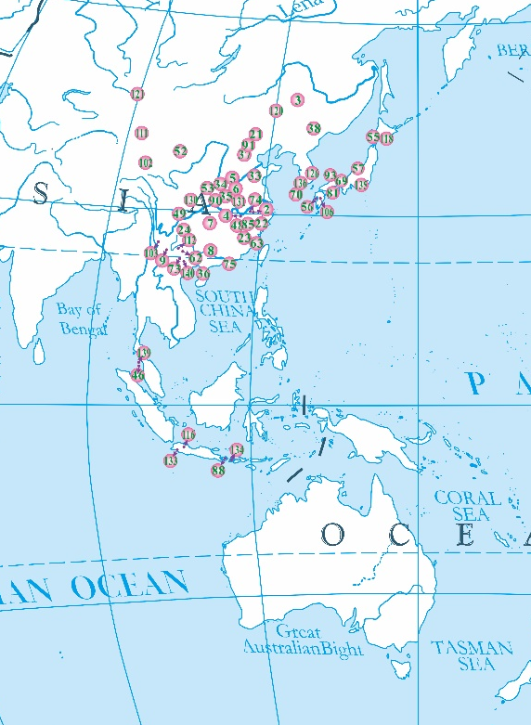
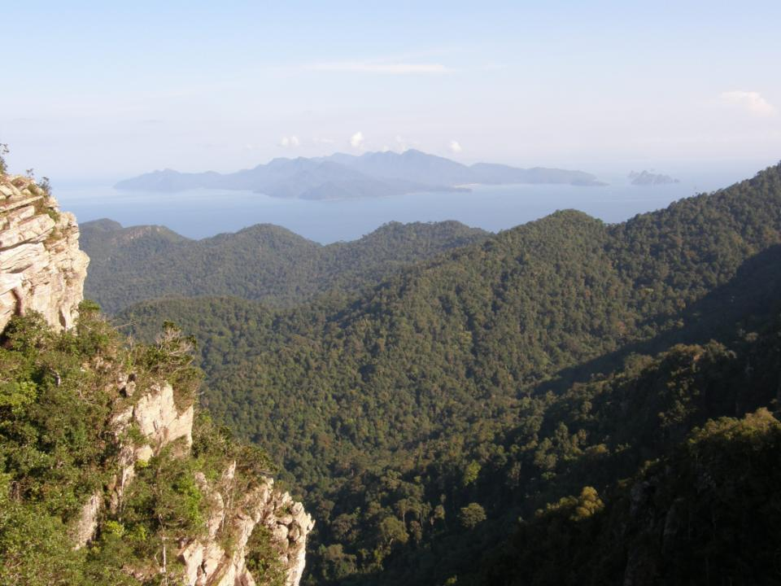
Langkawi UNESCO Global Geopark, Malaysia

Slide 21
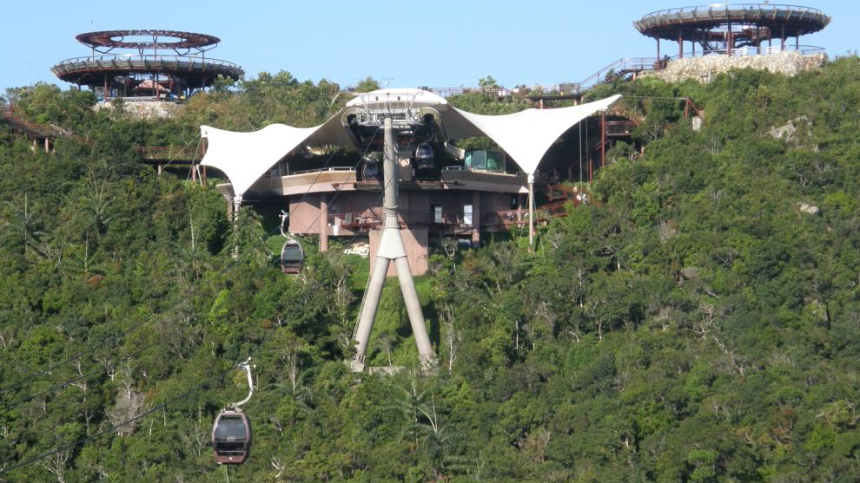
Access & Activity

Slide 22
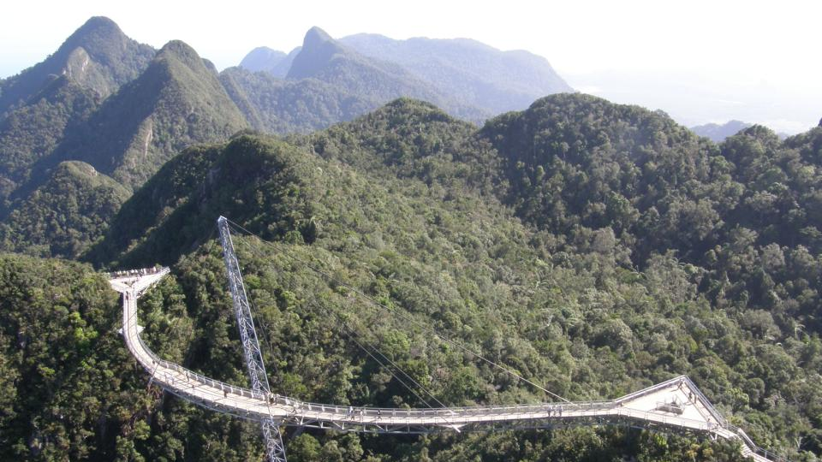
Activity and Attraction

Slide 23
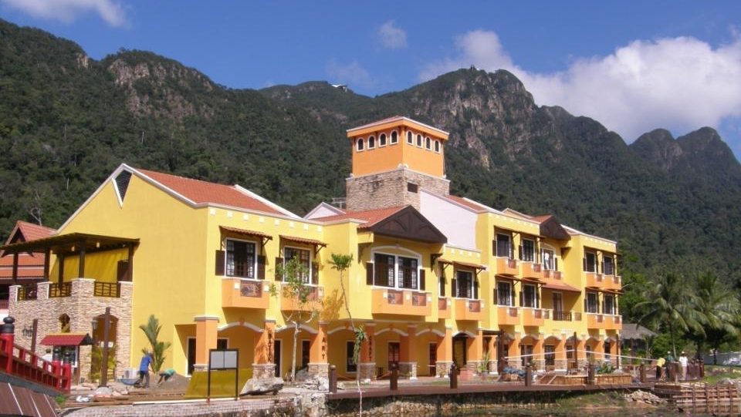
Accommodation

Slide 24
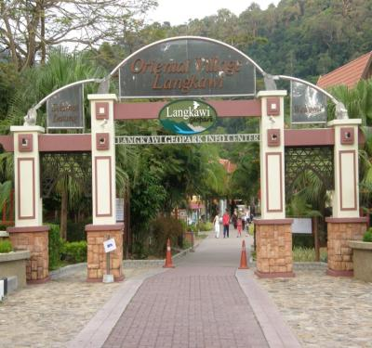
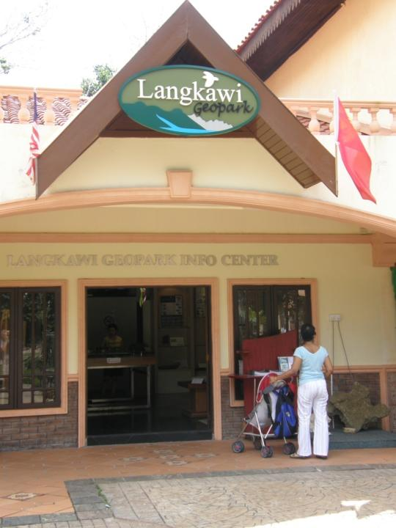
Awareness

Slide 25
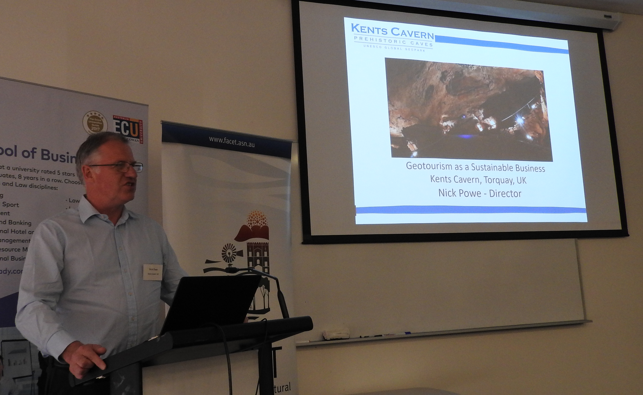
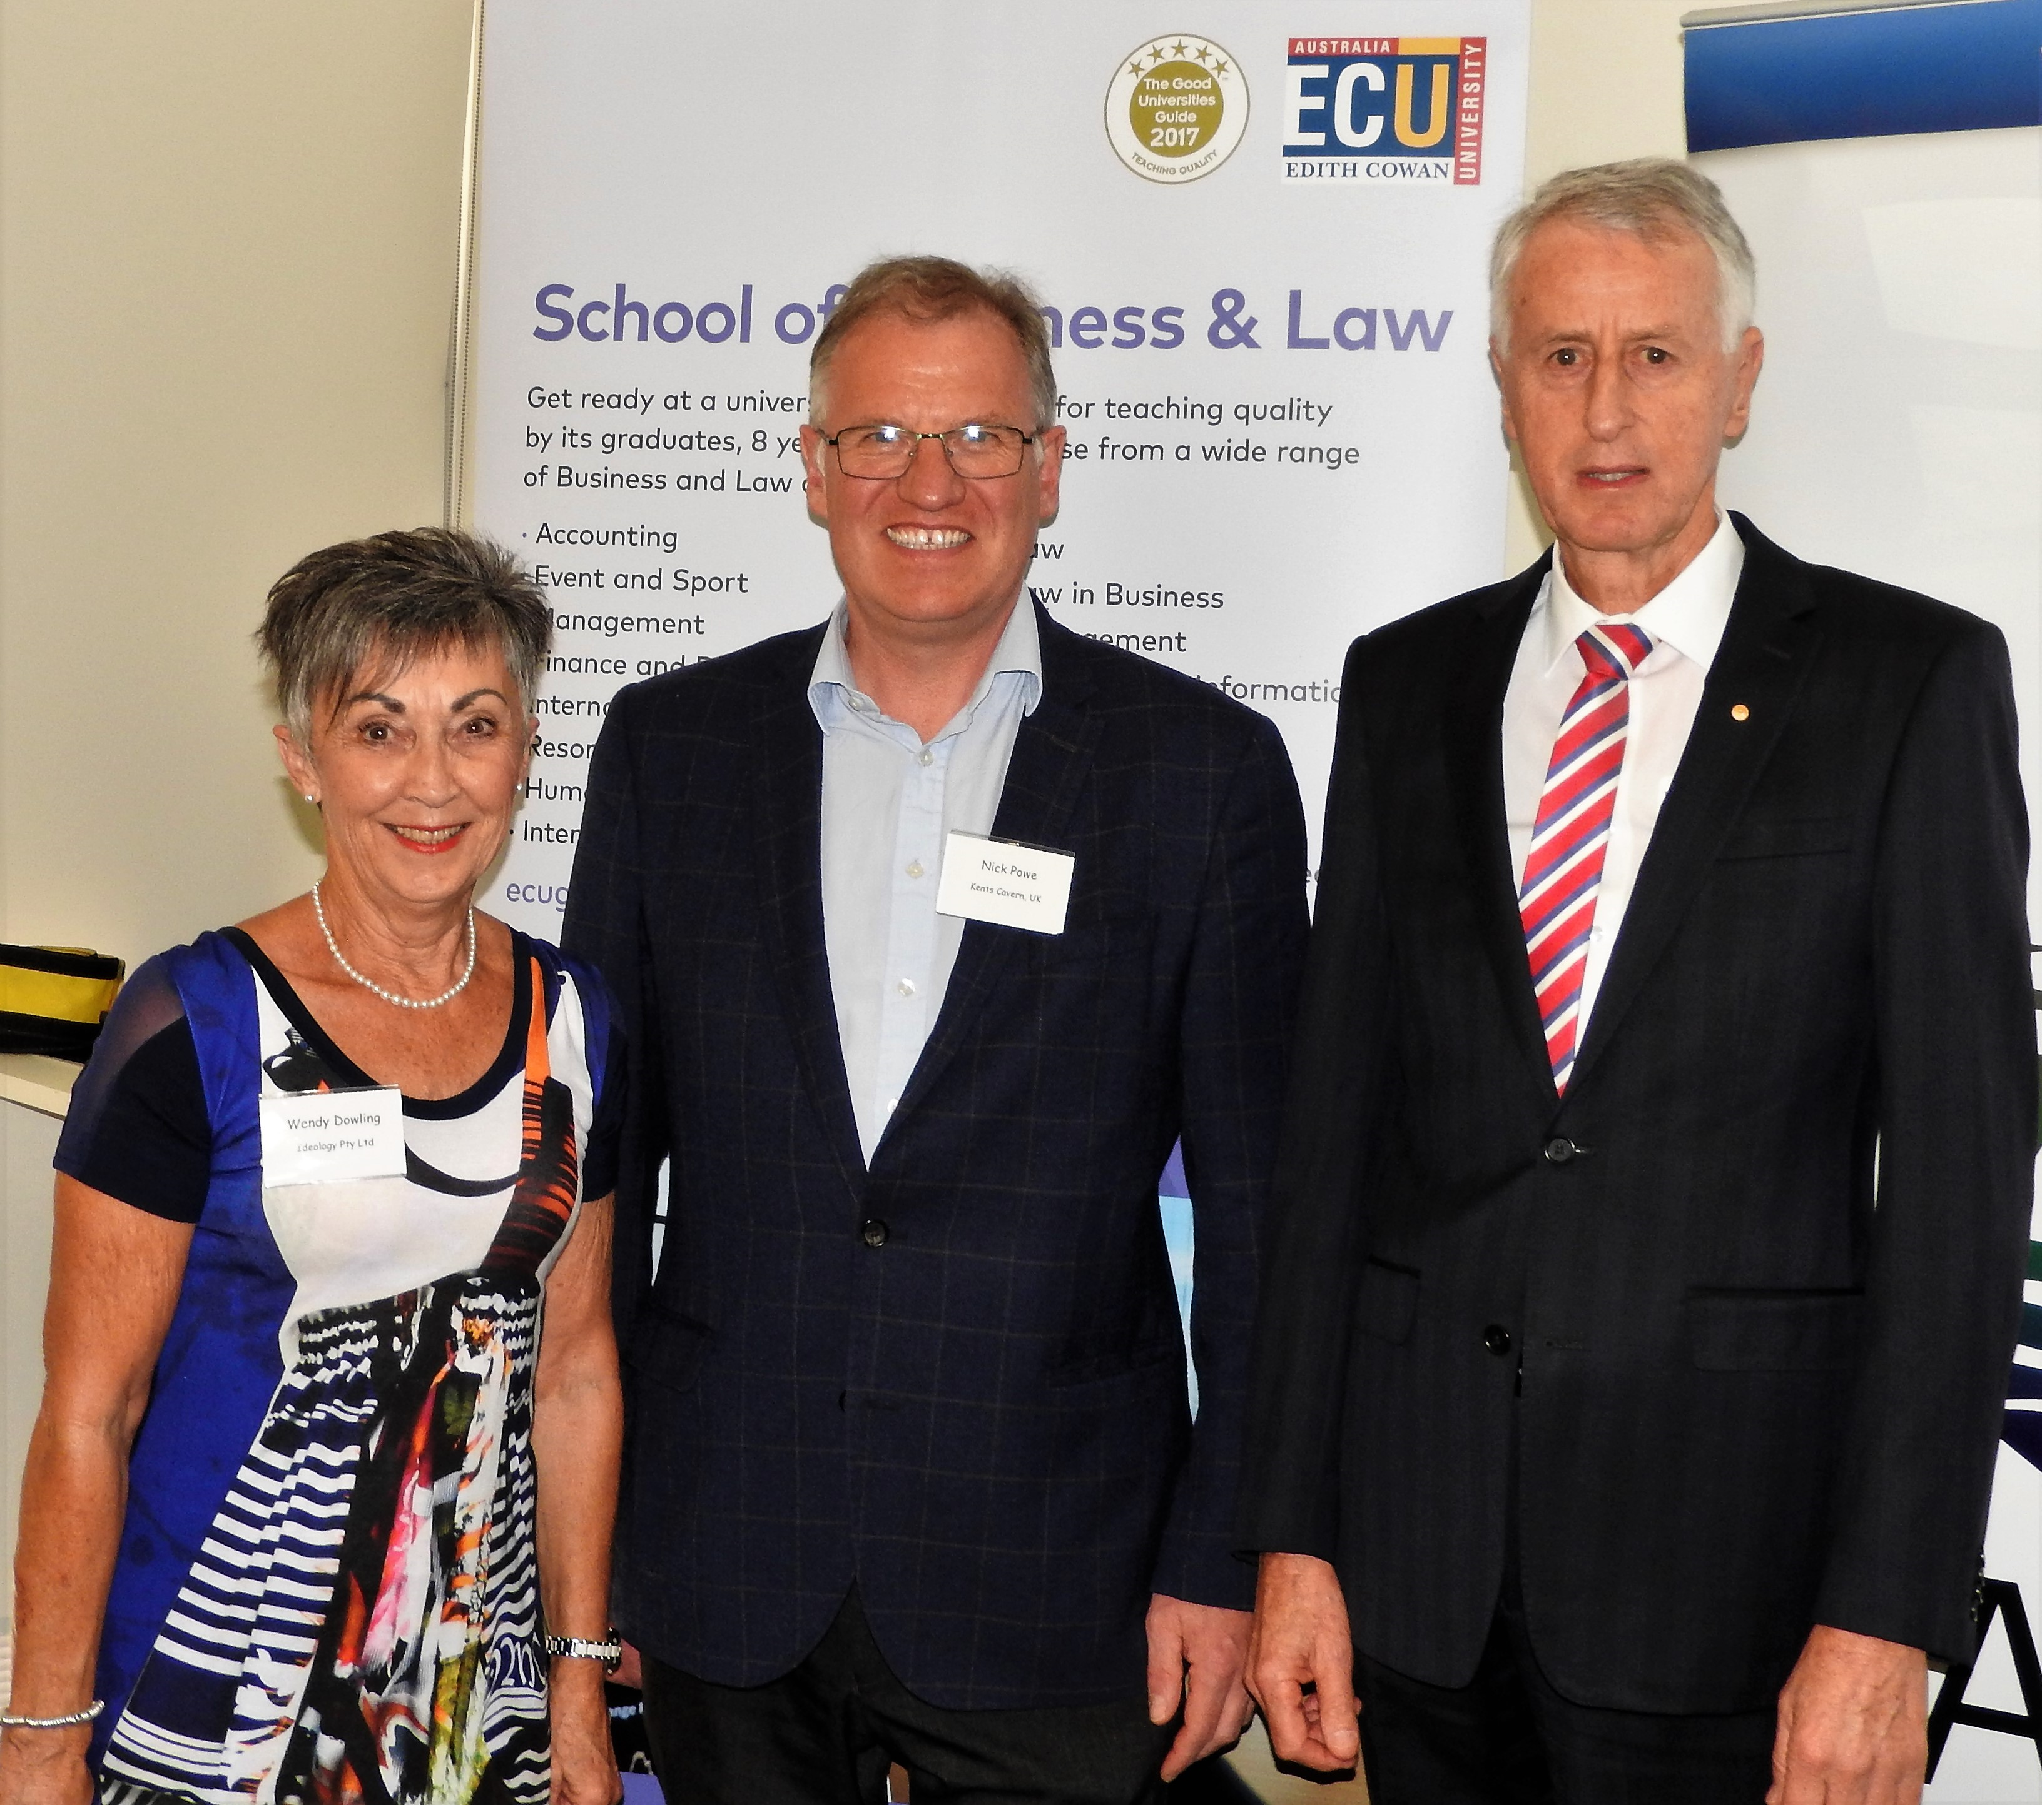
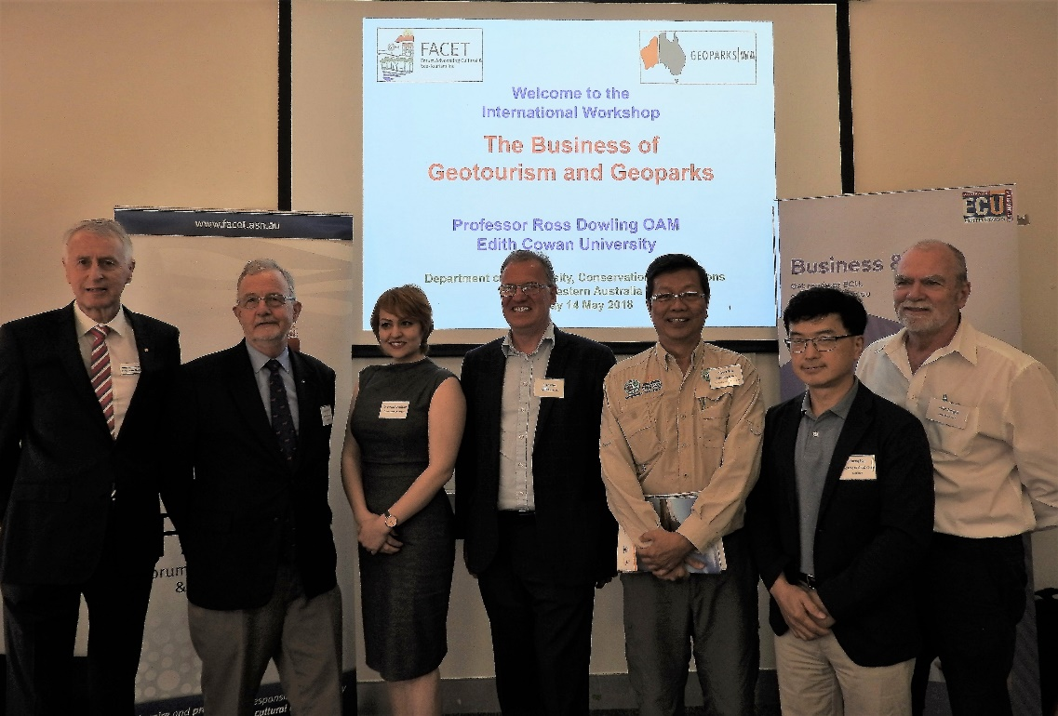
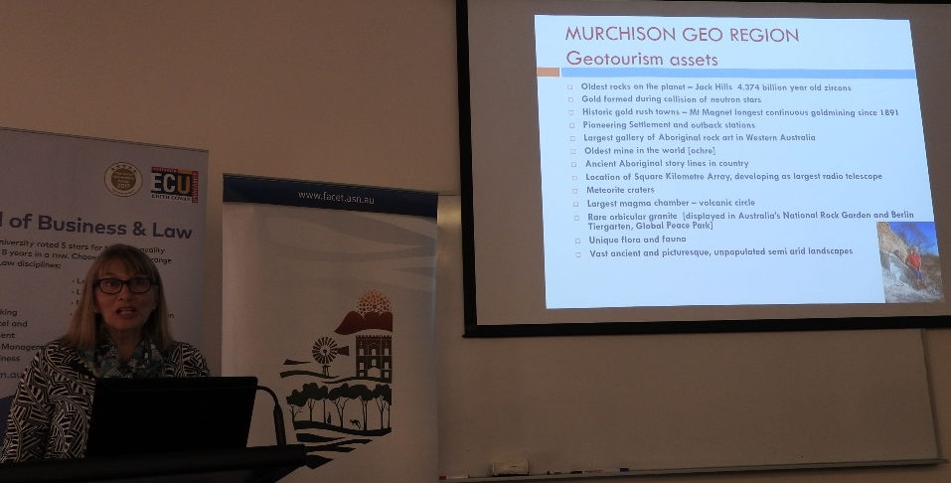
2018 – The Business of Geoparks Workshop, Perth
Nick Powe
Karen Morrissey

Slide 26
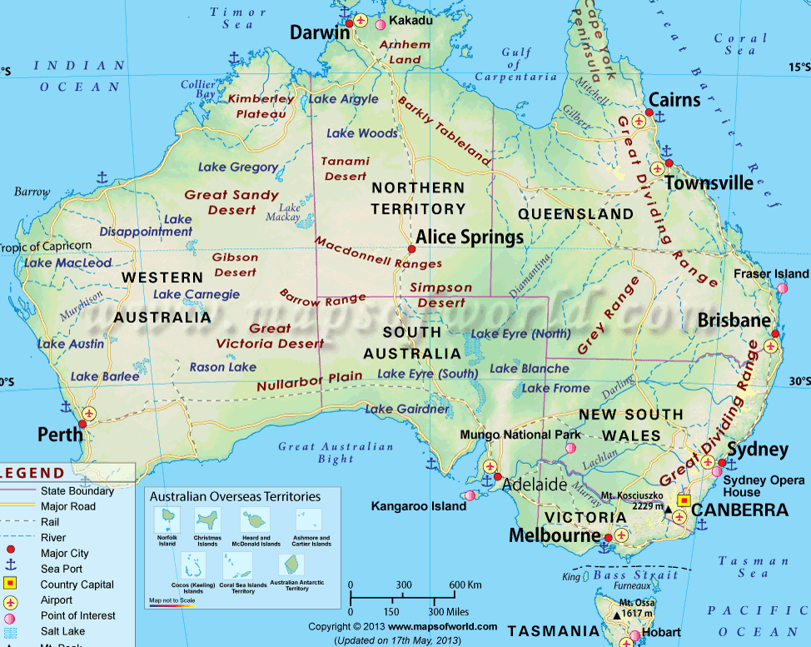
Australia’s Aspiring Geoparks

Slide 27
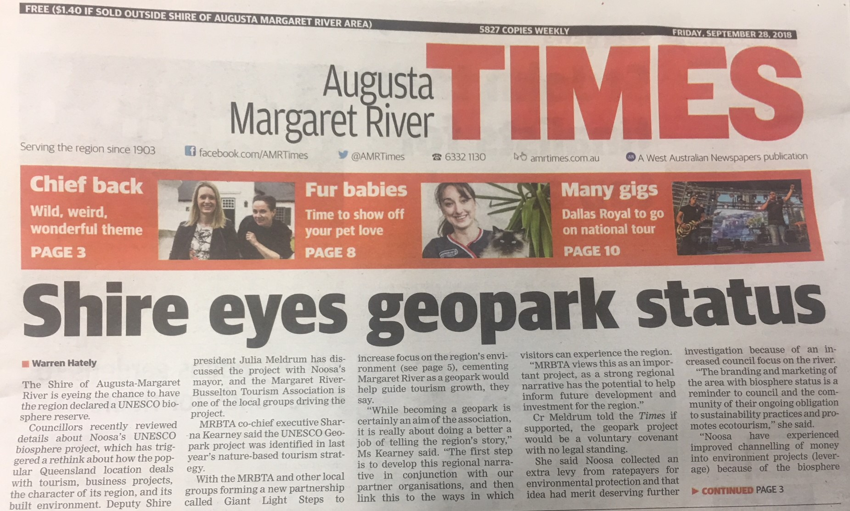
Margaret River
Augusta Margaret River Times - 28 September 2018

Slide 28
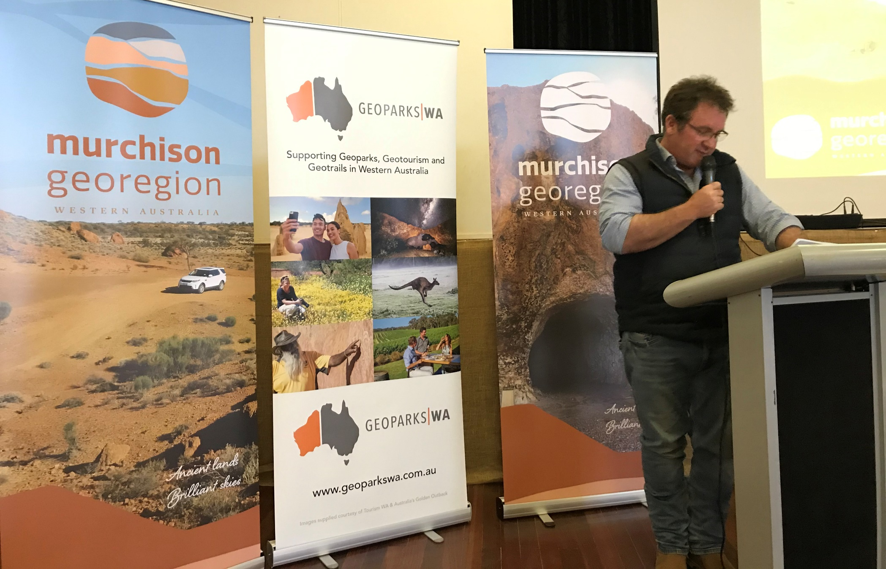
Murchison GeoRegion & Aspiring Geopark
Launched 18 September 2020

Slide 29

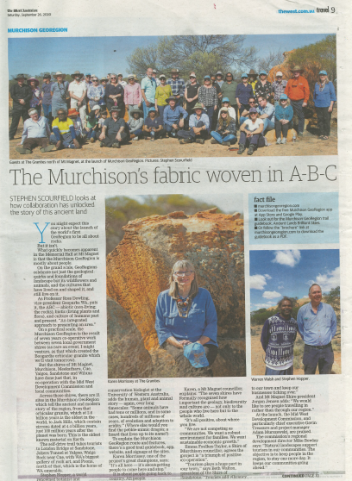
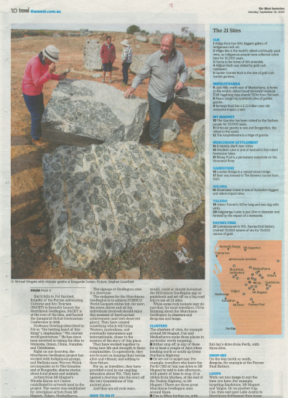
Two Page Spread in The West Australian
6 September 2020

Slide 30

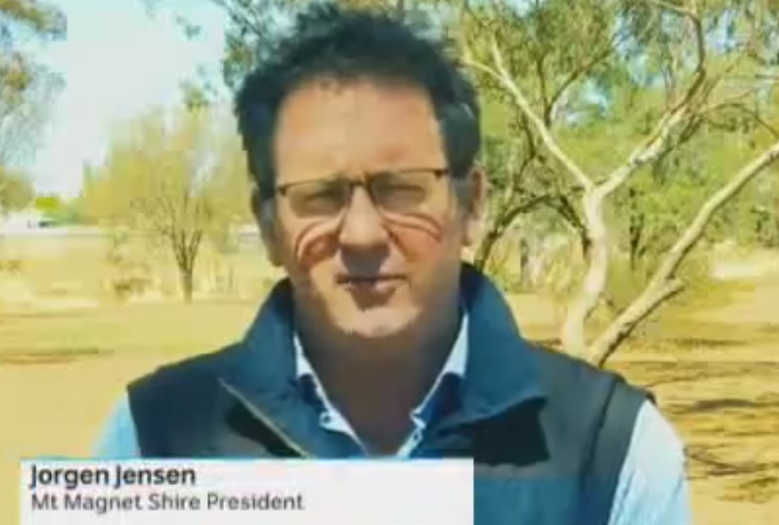
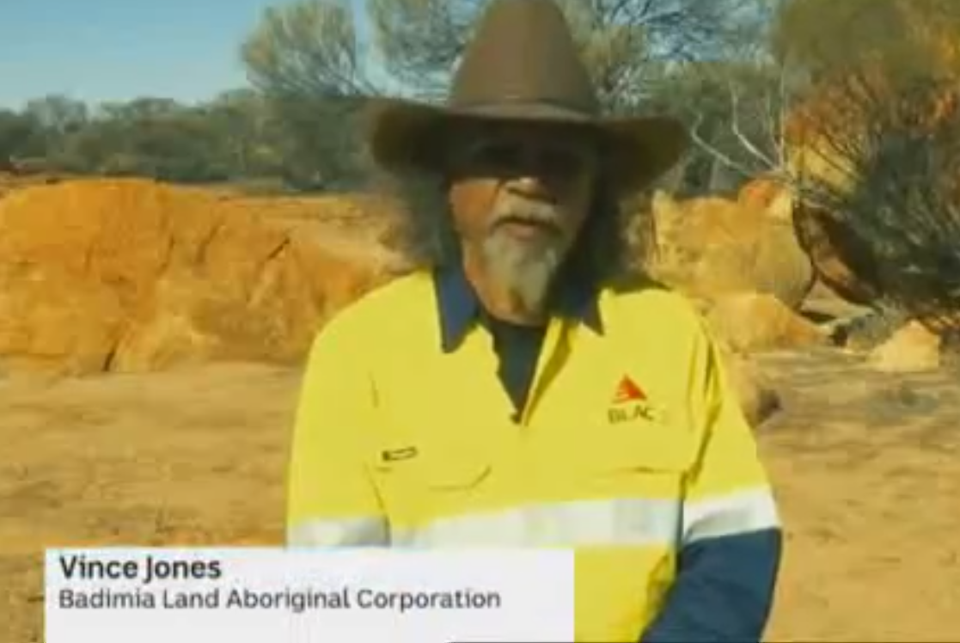
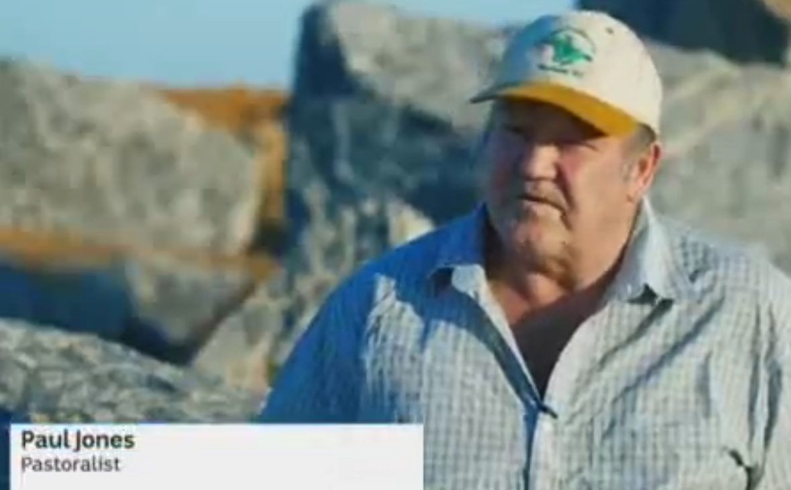
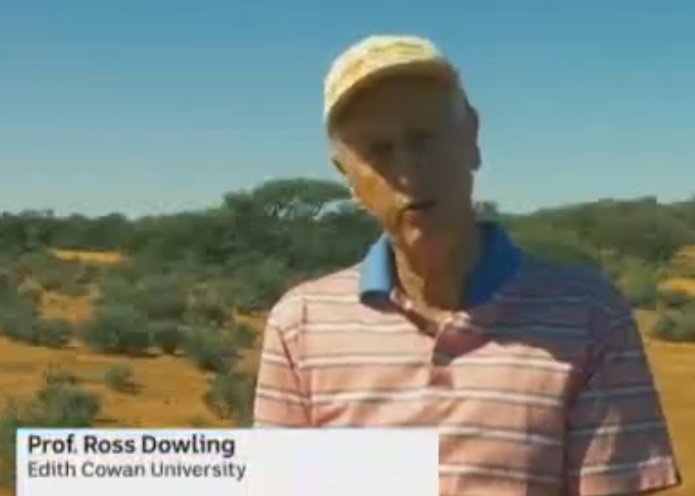
Nationwide ABC TV News
3 October 2020

Slide 31
Conclusions
Geoparks drive sustainable regional development
Their aim is to sustainably ‘add value’ to local or regional communities
This value should be easily measured through economic indicators such as jobs and revenue generation
We need geoparks in Australia

Slide 32
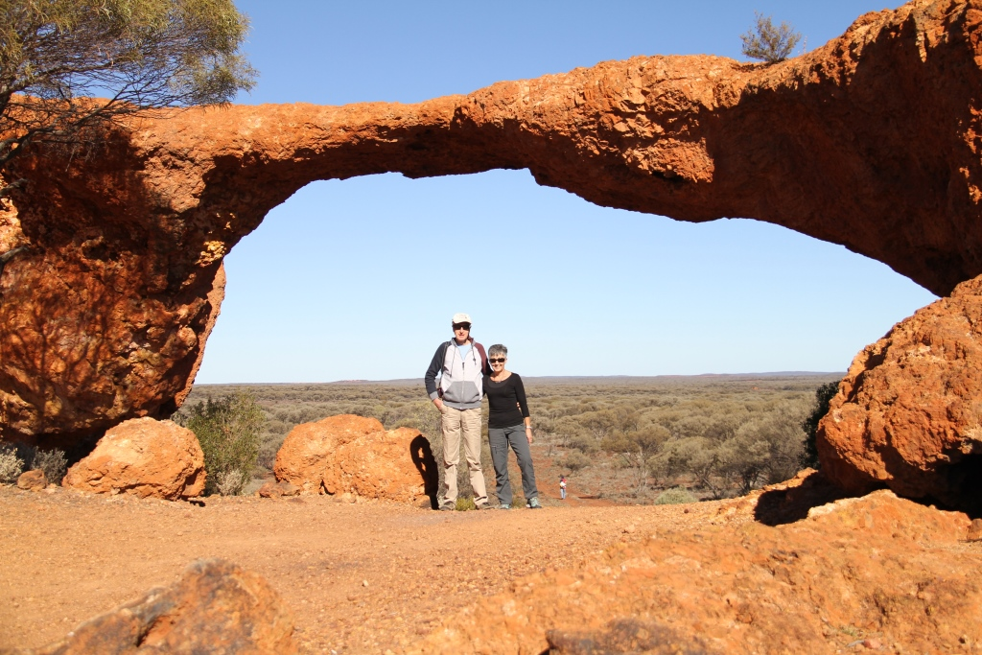
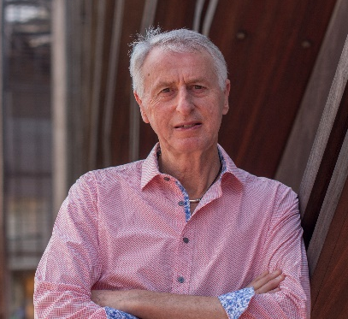
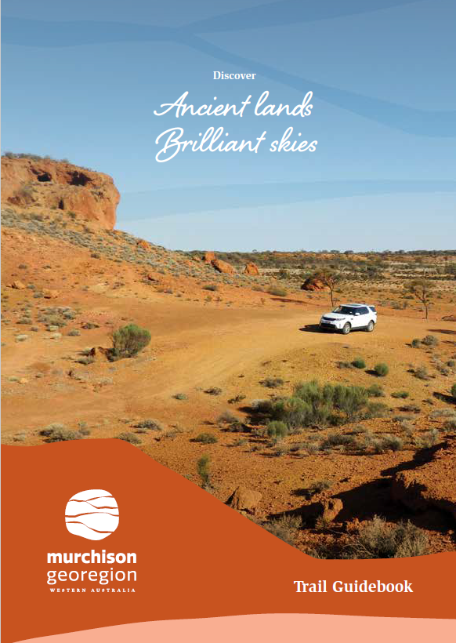
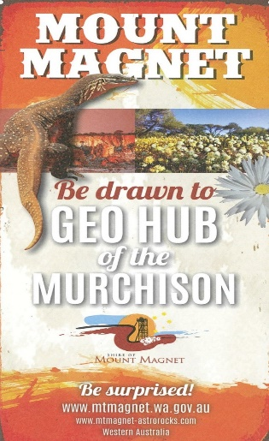
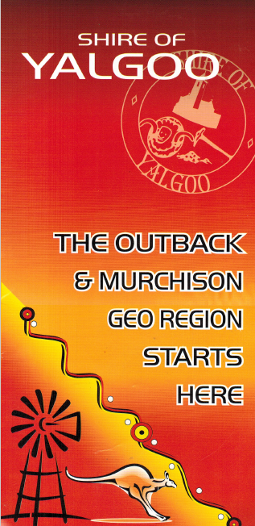
Geoparks
A powerful development vehicle for Australia
THE END
Ross Dowling
r.dowling@ecu.edu.au

