Slide 1
Stakeholder Perceptions Towards Geotourism, Geotrails and Geoparks
Presentation to AESC Conference, Adelaide
Alan Briggs – PhD Candidate

Slide 2
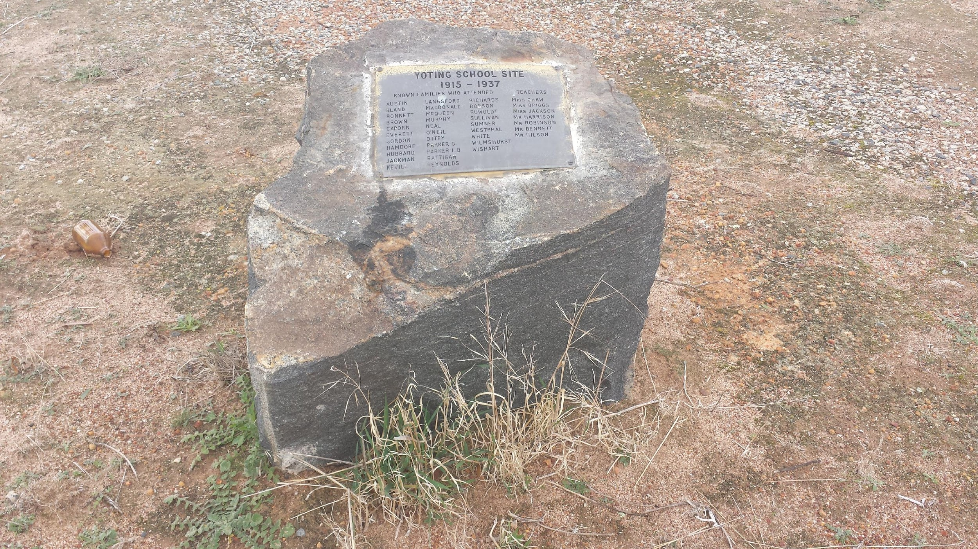
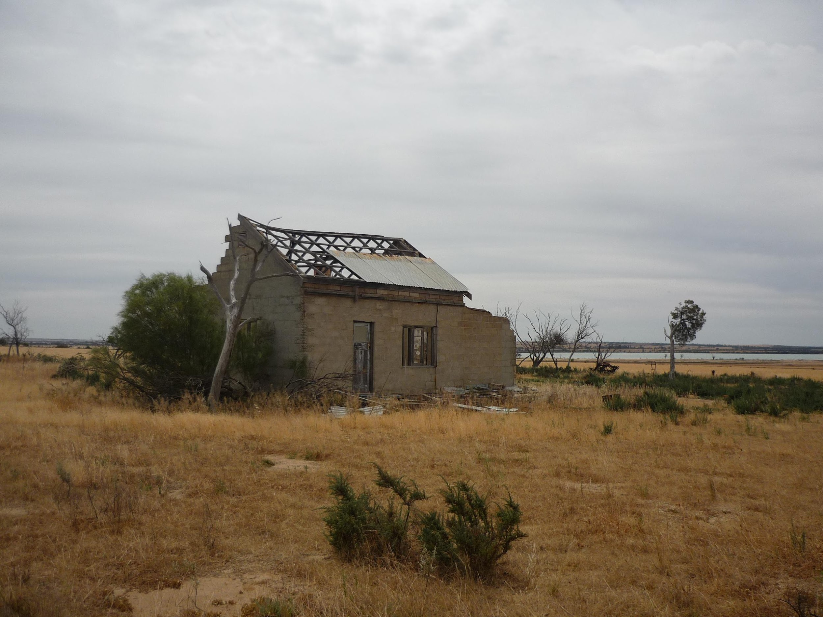
Trends in Agriculture in the Wheatbelt of Western Australia
Farm size increase
Employment replaced with technology
Farm houses vacated and or demolished
Town sizes diminishing, closing
Services in decline
Walk-offs increasing
Mental health issues (over 13% of population*)
and suicides increasing
Increasing regional macro-centres
(*Government of Western Australia WA Country Health Service, 2010)

Slide 3
Tourism - is it the Pancea?
Tourism has often been promoted as the “Way Forward”
Tourism creates employment, wealth and better communities
But, it is not a panacea …
Seasonal
Low pay
Leakage
Community dissent – within, between and to “outsiders”
This all implies Tourism needs to be well managed

Slide 4
Geotourism and Geotrails create an Opportunity
Developed in the 90s
Geotourism is sustainable tourism with a
primary focus on geological features, which
promotes environmental and cultural understanding,
appreciation and conservation, and
it is locally beneficial. (Dowling and Newsome, 2006)
Geotrails are pedestrian and/or vehicular access ways to view geological assets for conservation and education.

Slide 5
Geoparks
There are over 120 Global Geoparks, none in Australia!
Geoparks are managed with a holistic concept of protection, education and sustainable development.
Nomination to be a Geopark is said to be community oriented
Can Government nominated parks and reserves meet Geopark criteria?

Slide 6
Stakeholder Perception Research
Recent papers indicate mixed feelings after a Geopark has been established
Those engaged in businesses - tourism - are excited
Those who make their living from the land are not, some even feel their livelihood is threatened (Fanwei, 2014)

Slide 7
Western Australian Research in Advance of Establishing a Geopark
Haven’t been to Kanawinka … yet! That is on my agenda to review outcomes …
Rural decline is impacting my community
Tourism has a potential to provide an income stream
Communities are aware of the value of tourism
Why consider the Wheatbelt of Western Australia?
One of the oldest land forms in the world
Monadnocks, with unique flora and fauna
Ancient Aboriginal culture, oldest living culture in the world
Early explorer history and heritage, contemporary land uses

Slide 8
Granite Way Geopark (Aspiring)

Slide 9
Community Support in target Area
Local Government Authorities have provided strong support through CEOs
Community Development Officers have been made available as have their resources (offices, halls, catering)
Community members have attended forums, twice!
Online questionnaire didn’t work ... Where is the NBN?
Wheatbelt Development Commission has provided a grant to meet research costs.

Slide 10
Early Research Results
Findings from the study of stakeholders attending forums
The sample size is currently of sufficient size only to be indicative of the findings from research participants
Scale (Likert)
Strongly agree(1)
Agree(2)
Neither(3)
Disagree(4)
Strongly disagree(5)
Don’t know

Slide 11
Q Tourists are interested in learning about Australia
Frequency Percent Valid (%) Cumulative (%)
Valid: 1 7 5.9 33.3 33.3
2 13 11.0 61.9 95.2
3 1 .8 4.8 100.0
Total 21 17.8 100.0

Slide 12
Q Tourism can have a positive impact on the local community
Frequency Percent Valid(%) Cumulative (%)
Percent
Valid 1 11 9.3 52.4 52.4
2 10 8.5 47.6 100.0
Total 21 17.8 100.0

Slide 13
Q There is local community support for tourism development
Frequency Percent Valid Percent Cumulative Percent
Valid 97 82.2 82.2 82.2
1 3 2.5 2.5 84.7
2 9 7.6 7.6 92.4
3 5 4.2 4.2 96.6
4 2 1.7 1.7 98.3
Don't know 2 1.7 1.7 100.0

Slide 14
Q Local businesses support the creation of a Geopark
Frequency Percent Valid (%) Cumulative (%)
Valid 82.2 82.2 82.2
2 5 4.2 4.2 86.4
3 4 3.4 3.4 89.8
Don't know 12 10.2 10.2 100.0
Total 100.0 100.0

Slide 15
Q Community participation in planning a Geopark is required
Frequency Percent Valid (%) Cumulative (%)
Valid 1 6 5.1 28.6 28.6
2 13 11.0 61.9 90.5
3 1 .8 4.8 95.2
4 1 .8 4.8 100.0
Total 21 17.8 100.0

Slide 16
Q There is capacity in our community to support a Geopark
Frequency Percent Valid (%) Cumulative (%)
Valid 82.2 82.2 82.2
1 5 4.2 4.2 86.4
2 12 10.2 10.2 96.6
3 1 .8 .8 97.5
4 1 .8 .8 98.3
Don't know 2 1.7 1.7 100.0
Total 100.0 100.0

Slide 17
Q Do you believe there are areas of geological significance supporting a Geopark
Frequency Percent Valid (%) Cumulative (%)
Valid 1 18 15.3 94.7 94.7
2 1 .8 5.3 100.0
Total 19 16.1 100.0

Slide 18
Q15.2 Fund raising via LGAs (Business levy)
Frequency Percent Valid (%) Cumulative (%)
Valid
2 2 1.7 1.7 84.7
3 4 3.4 3.4 88.1
4 10 8.5 8.5 96.6
5 2 1.7 1.7 98.3
Don't know 2 1.7 1.7 100.0

Slide 19
Q15.7 Government funding for the Geopark
Frequency Percent Valid (%) Cumulative (%)
Valid 83.1 83.1 83.1
1 5 4.2 4.2 87.3
2 11 9.3 9.3 96.6
3 3 2.5 2.5 99.2
Don't know 1 .8 .8 100.0

Slide 20
Summary
Communities in Western Australia recognise the potential of tourism
Not many know about Geoparks. There is limited awareness of them
WA communities in the Wheatbelt believe there are geological assets that would link into Geotourism and Geotrails (Granite Way in one such drive trail)
From previous research Geoparks have the potential to address rural decline through creating tourism opportunities under Geopark branding
Further work is required to raise awareness of the value of Geoparks at community and political levels

Slide 21
Thank you
I recognise the support of:
Murdoch University
CEOs of Tammin, Kellerberrin, Bruce Rock and Quairading
and their Community Development Officers
Wheatbelt Development Commission
And the opportunity to present at the AESC
Contact: a.briggs@murdoch.edu.au

