Slide 1
Stakeholder Perceptions about Geoparks:
Addressing the Perceptions and Myths
A presentation to the Global Eco Asia-Pacific Tourism Conference, Margaret River, Western Australia, by Dr Alan Briggs
3 December, 2020

Slide 2

The Plan
Cover definitions
Outline the research
Show the findings
Produce some general facts
Address the perceptions and myths

Slide 3
Definitions:
Geodiversity:
Geoheritage:
Geotourism:
Geotrails:
Geoparks:

Slide 4
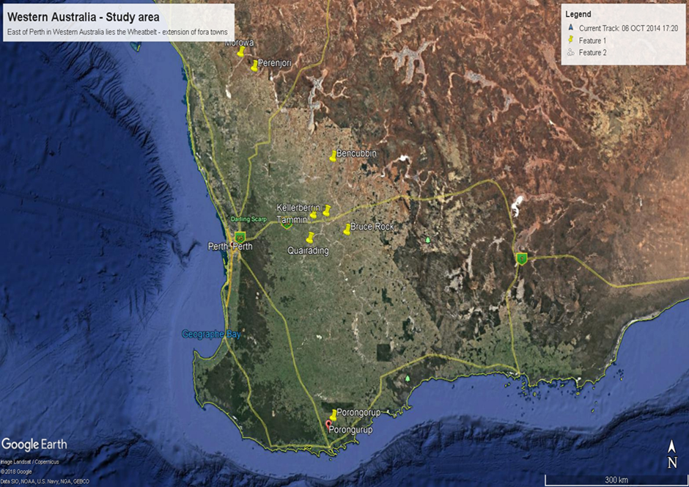
The Research
Determine stakeholder perceptions about establishing a Geopark in the Wheatbelt.
The field research included forums and interviews.
Forums were conducted across the Wheatbelt of Western Australia.
Interviews were focused on stakeholders nominated through the forum process.
Extensive literature reviews were carried out.

Slide 5
Research Findings
Rural decline in population, employment, local businesses, social opportunities, health, and reduced emergency services as volunteer support ebbed away.
Any prospect of creating businesses and employment in the Wheatbelt, bring it on!
Geoparks: a means of coordinating sustainable tourism across the Wheatbelt.
Aboriginal culture and people had to be included.
No conflicts, nor confusion, were raised about geoparks.
No conflict for funds; the term “park”; mining; or green veneer of UNESCO.
Stakeholders recognised that there were no legislative or other requirements associated with geoparks, other than having an incorporated body to manage the geopark.

Slide 6
Why are we so far behind the rest of the world?
Kanawinka Global geopark didn’t quite dot all the “i’s” or cross all the “ts”.
Local government authorities (7) were on board. A Federal MP and one State MP had provided letters of support.
UNESCO Australia supported the proposal.
Government agency response was the 2009 communique. No further interaction with UNESCO! Was this based on WHAs and MaBs? Why didn’t they consider the tourism potential for regional areas?
WA is different with vast areas with no major towns, no mining, and no jobs. Sustainable tourism will assist rural towns get back on their feet.

Slide 7
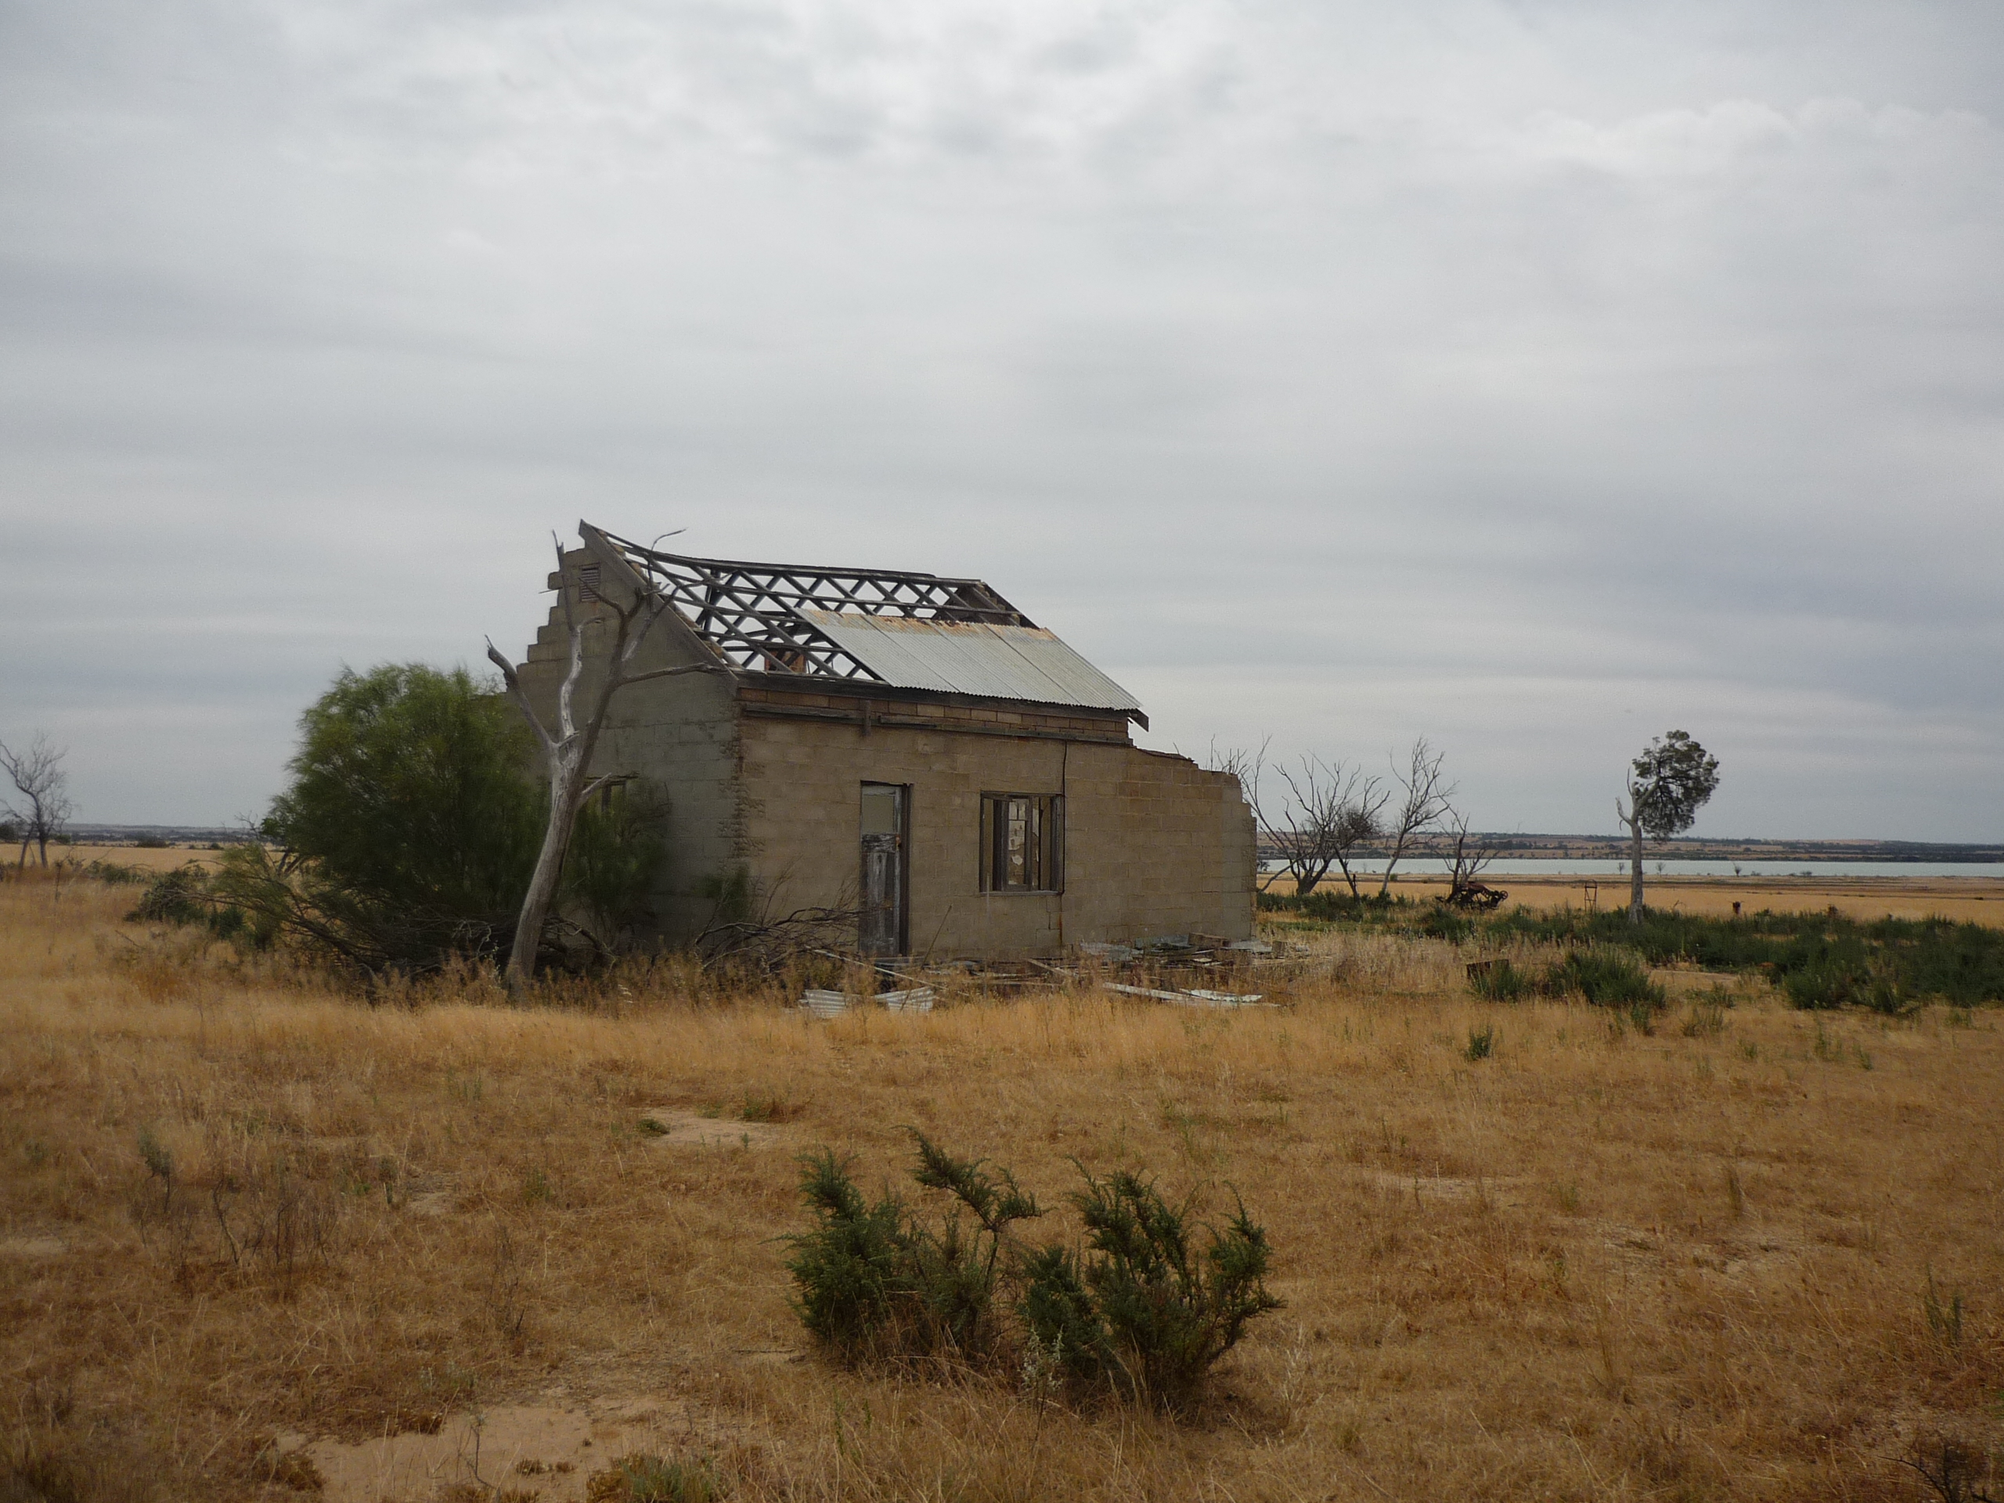
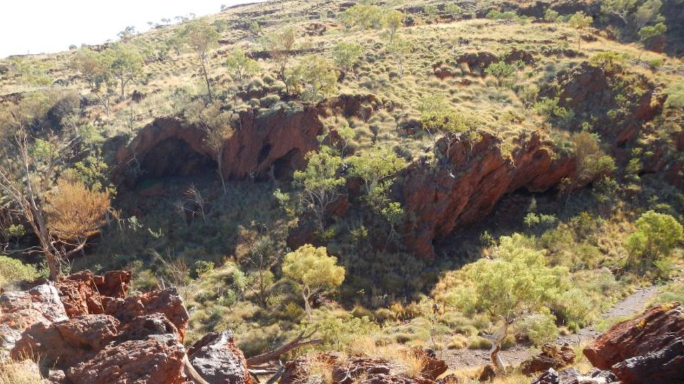
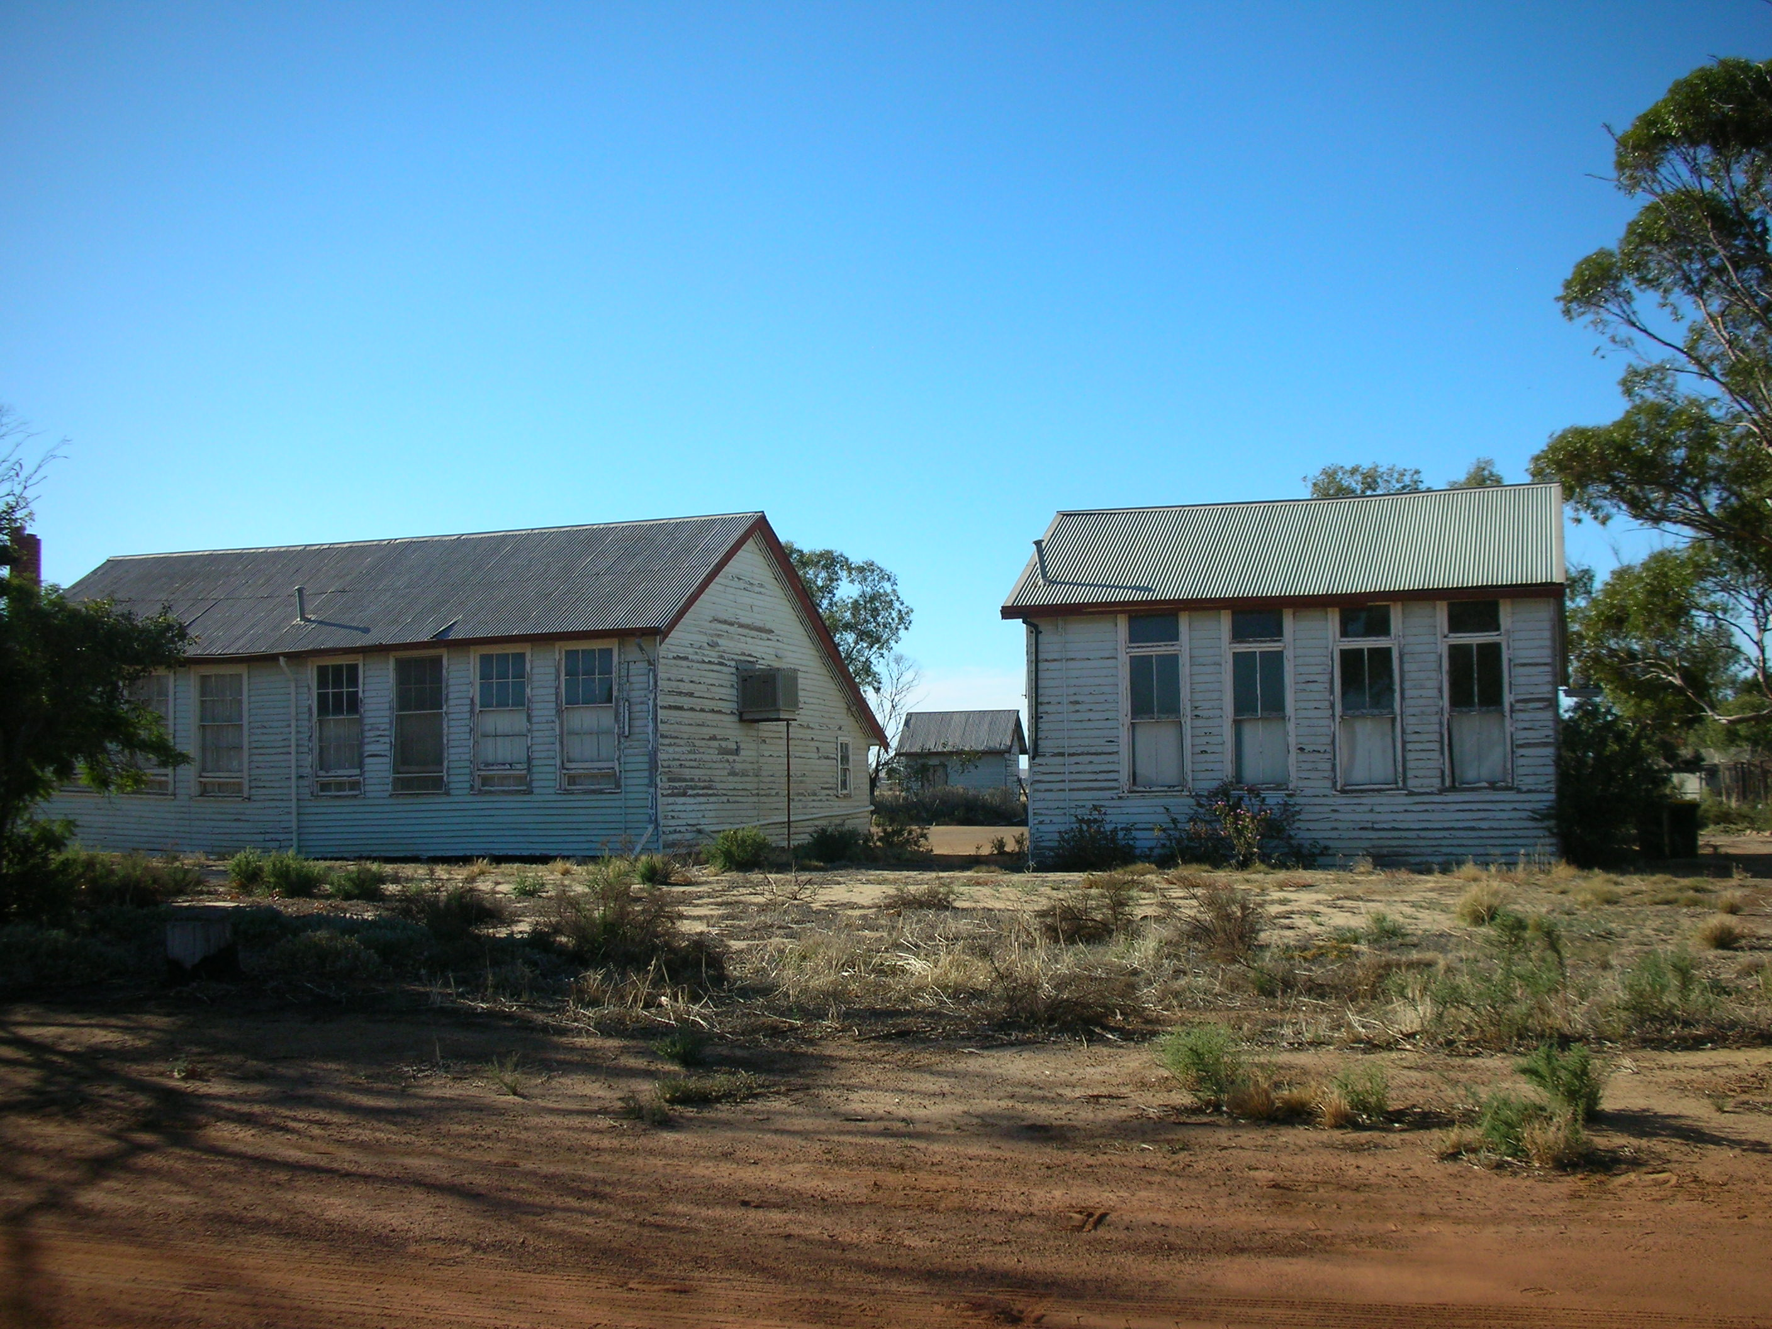
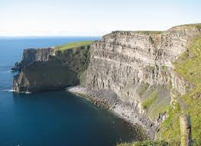
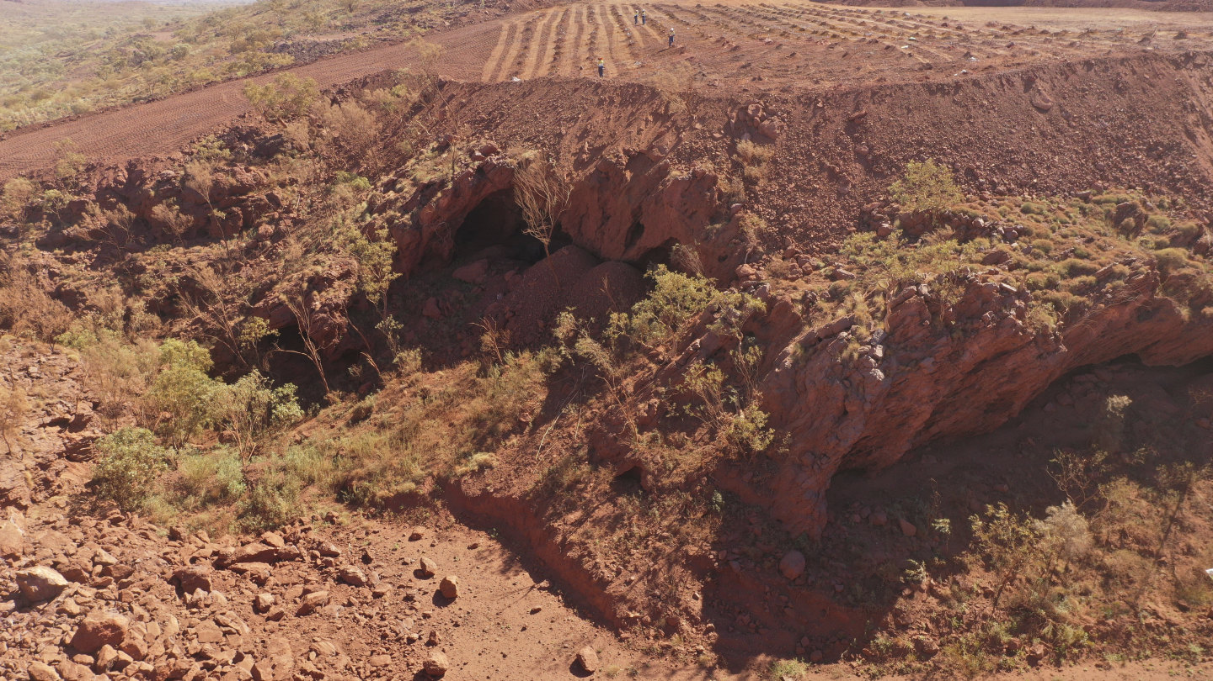
Just some stuff

Slide 8

Employment comparison
2020: Tourism - 611,700 jobs. 18% fewer than the 2019 748,200 jobs. Over the same period, the number of jobs in the Australian labour force fell by 7% – confirming that tourism continues to be one of the most impacted sectors of the economy (ABS, 2020). 1 in 13 workers (8%) of the work force (AFR).
Mining : 247,300 persons (ABS trend data), 2.0 per cent of the total workforce. Over the past five years, employment in the industry has increased by 2.3 per cent.

Slide 9
Financial Comparison
In 2019, tourism in Australia accounted for 3.1% of the national GDP, contributing $60.8 billion to the Australian economy. The means that tourism GDP grew at a faster rate than the national economy. Of this, 26% came from international visitors to Australia while 74% came from domestic tourism. (https://www.budgetdirect.com.au/travel-insurance/research/tourism-statistics.html#:~:text=In%202019%2C%20tourism%20in%20Australia,74%25%20came%20from%20domestic%20tourism). (2020)
Australia forecast mining sector revenue at $282 billion, down $3 billion from its June forecast, but still ahead of a record $279 billion in 2018/19. “The outlook for the world economy remains uncertain. (https://www.reuters.com/article/australia-mining-idUSL3N26L0OI) Sep 29, 2019

Slide 10


What are the perceptions and myths?
Derived from the research and subsequent engagement in the eastern States.
The following information is extracted from, and expanded in, a paper submitted to the Journal of Tourism Futures.

Slide 11

Legislative and policy implications
UNESCO Global Geopark: no changes to a country’s laws (UNESCO, 2017a).
Host nations to provide the appropriate level of support within its own means, such as existing legislation and policies.
In Australia, legislation at Federal and State levels exists for the protection of geoheritage sites.
However, geoheritage is not the sole focus of Geoparks.
Is this a hangover from World heritage Areas and Man and the Biosphere?

Slide 12

Perceived conflict between National Parks and Geoparks
Not one stakeholder raised this as a concern.
There might be a conflict over resources but aren’t governments meant to fund parks?
Geoparks would seek grants, sponsorships, philanthropy and donations … not necessarily in conflict with National Parks.
Surely communities should be allowed to make their own decisions!

Slide 13
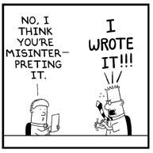
Confusion over terminology
Yes, the term “park” might cause some confusion, but none was found in this research!
Perhaps the community should be given some credit.
The term “Conservation Park” was added into the CALM Act in 1984. Maybe we should add “Geopark” to the legislation?
Perhaps just commonsense should prevail and accept geopark as a global term.
There is much more to this than musing over a word.

Slide 14
Mining conflict perceived in Geoparks
Australian Resource Ministers have a negative perception about the influence of Geopark status on exploration and mining, or is that the Resources agencies?
Recent east coast experience with Etheridge LGA. But how real is it?
In the global context, there exist Geoparks with mining ie Terra Vita (Germany) and Brazil’s Iron Quadrangle Geopark as an aspiring Geopark.
Yes, there are some areas of concern: ie proposed uranium mining of in the Naturtejo Global Geopark in Portugal with the local community showing “distrust for the proposed mining enterprise”

Slide 15
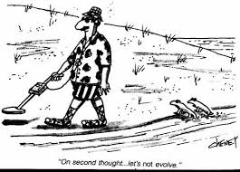
Mineral fossicking conflict
Prospecting in Geoparks is permitted under managed conditions. The Naturtejo Global Geopark (Portugal) encourages visitors to learn about early means of prospecting to fossick for gold nuggets in a river.
Prospecting in Australia requires a license and approval of the owners of the land and the lease. It is an ongoing activity and is therefore addressed under existing State legislation.

Slide 16


Perceived green veneer of UNESCO
UNESCO is about Education, Science and Conservation.
Yes, there can be a perception, but is it real?
Missed potential of Geoparks as marketing opportunities
Using UNESCO’s brand and worldwide appeal would bring tourists to Geoparks as they do for World Heritage Areas and Man and the Biosphere sites.

Slide 17
Is it right?
That agencies can deny rural areas the right to create businesses and jobs?
That information provided to Ministers reflects myths and perceptions?
Mining agencies want a better understanding of geosciences.
Conservation agencies want improved conservation outcomes.
Surely Australian communities would be better served if mining and conservation worked together to enable business growth and job creation through sustainable regional tourism.
Education through geoparks can assist in achieving these outcomes.

Slide 18
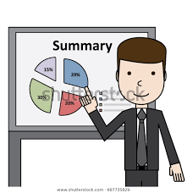
Summary
The research demonstrated that rural community and tourism business stakeholders do not see conflict with geoparks.
The 2009 communique should be reviewed following Covid19.
Regional tourism businesses and jobs should be prioritised.
Geoparks should be embraced by the conservation and resources agencies.
The mining industry should support geoparks to celebrate geoheritage, grow interest in geology, and support research in geoscience.
Geoparks are more than geotourism. They embrace communities, encourage sustainable tourism, encourage conservation of geoheritage, promote employment, and assist in revitalising rural areas.

Slide 19

Thank you for listening
Dr Alan Briggs
President, Geoparks WA
Email: alanbriggsnhc@dodo.com.au
Mobile: 0429 914 051

